Slide 1
Chapter 7
SQL – Data Definition
Pearson Education © 2014

Slide 2

Chapter 7 - Objectives
Data types supported by SQL standard.
Purpose of integrity enhancement feature of SQL.
How to define integrity constraints using SQL.
How to use the integrity enhancement feature in the CREATE and ALTER TABLE statements.
Pearson Education © 2014

Slide 3
Chapter 7 - Objectives
Purpose of views.
How to create and delete views using SQL.
How the DBMS performs operations on views.
Under what conditions views are updatable.
Advantages and disadvantages of views.
How the ISO transaction model works.
How to use the GRANT and REVOKE statements as a level of security.
Pearson Education © 2014

Slide 4
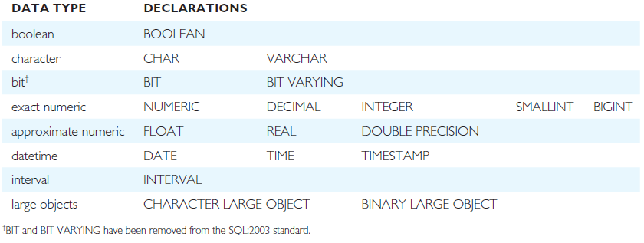
ISO SQL Data Types
Mention char, varchar, nchar, and nvarchar in T-SQL. Also datetime.
Pearson Education © 2014

Slide 5

Integrity Enhancement Feature
Consider five types of integrity constraints:
  required data
  domain constraints
  entity integrity
  referential integrity
  general constraints.
Pearson Education © 2014

Slide 6
Integrity Enhancement Feature
Required Data
  position VARCHAR(10) NOT NULL
Domain Constraints
  (a) CHECK
  sex CHAR NOT NULL
  CHECK (sex IN (‘M’, ‘F’))
Pearson Education © 2014

Slide 7
Integrity Enhancement Feature
  (b) CREATE DOMAIN (NOT in T-SQL, but can use the CHECK constraint instead)
    CREATE DOMAIN DomainName [AS] dataType
    [DEFAULT defaultOption]
    [CHECK (searchCondition)]
For example:
  CREATE DOMAIN SexType AS CHAR
  CHECK (VALUE IN (‘M’, ‘F’));
  sex SexType NOT NULL
Pearson Education © 2014

Slide 8
Integrity Enhancement Feature
searchCondition can involve a table lookup:
  CREATE DOMAIN BranchNo AS CHAR(4)
  CHECK (VALUE IN (SELECT branchNo
  FROM Branch));
Domains can be removed using DROP DOMAIN (Not in T-SQL) :
  DROP DOMAIN DomainName
  [RESTRICT | CASCADE]
Pearson Education © 2014

Slide 9
IEF - Entity Integrity
Primary key of a table must contain a unique, non-null value for each row.
ISO standard supports PRIMARY KEY clause in CREATE and ALTER TABLE statements:
  PRIMARY KEY(staffNo)
  PRIMARY KEY(clientNo, propertyNo)
Can only have one PRIMARY KEY clause per table. Can still ensure uniqueness for alternate keys using UNIQUE:
  UNIQUE(telNo)
Pearson Education © 2014

Slide 10
IEF - Referential Integrity
FK is column or set of columns that links each row in child table containing foreign FK to row of parent table containing matching PK.
Referential integrity means that, if FK contains a value, that value must refer to existing row in parent table (value could also be NULL).
ISO standard supports definition of FKs with FOREIGN KEY clause in CREATE and ALTER TABLE:
  FOREIGN KEY(branchNo) REFERENCES Branch
Pearson Education © 2014

Slide 11
IEF - Referential Integrity
Any INSERT/UPDATE attempting to create FK value in child table without matching CK(candidate key) value in parent is rejected.
Action taken attempting to update/delete a CK value in parent table with matching rows in child is dependent on referential action specified using ON UPDATE and ON DELETE subclauses:
  CASCADE - SET NULL
  SET DEFAULT - NO ACTION
Pearson Education © 2014

Slide 12
IEF - Referential Integrity
CASCADE: Delete row from parent and delete matching rows in child, and so on in cascading manner.
SET NULL: Delete row from parent and set FK column(s) in child to NULL. Only valid if FK columns are NOT NULL.
SET DEFAULT: Delete row from parent and set each component of FK in child to specified default. Only valid if DEFAULT specified for FK columns.
NO ACTION: Reject delete from parent. Default.
Pearson Education © 2014

Slide 13
IEF - Referential Integrity
Let’ say the following is in the Property table :
FOREIGN KEY (staffNo) REFERENCES Staff ON DELETE SET NULL
FOREIGN KEY (ownerNo) REFERENCES Owner ON UPDATE CASCADE
Teacher – explain what the above would do.
Pearson Education © 2014

Slide 14
IEF - General Constraints (Business rules)
Could use CHECK/UNIQUE in CREATE and ALTER TABLE.
Similar to the CHECK clause, also have:
  CREATE ASSERTION AssertionName
  CHECK (searchCondition)
Pearson Education © 2014

Slide 15
IEF - General Constraints
  In CREATE TABLE for PropertyForRent table, we could
  CREATE ASSERTION StaffNotHandlingTooMuch
  CHECK (NOT EXISTS (SELECT staffNo
  FROM PropertyForRent
  GROUP BY staffNo
  HAVING COUNT(*) > 100))
Pearson Education © 2014

Slide 16
Data Definition
SQL DDL allows database objects such as schemas, domains, tables, views, and indexes to be created and destroyed.
Main SQL DDL statements are:
  CREATE SCHEMA (Is in T-SQL) DROP SCHEMA
  CREATE/ALTER DOMAIN (Is in T-SQL) DROP
  DOMAIN
  CREATE/ALTER TABLE DROP TABLE
  CREATE VIEW DROP VIEW
Many DBMSs also provide:
  CREATE INDEX DROP INDEX
Pearson Education © 2014

Slide 17
Data Definition
Relations and other database objects exist in an environment.
Each environment contains one or more catalogs, and each catalog consists of set of schemas.
Schema is named collection of related database objects.
Objects in a schema can be tables, views, domains, and assertions. All have the same owner.
Pearson Education © 2014

Slide 18
CREATE TABLE
  CREATE TABLE TableName
  {(colName dataType [NOT NULL] [UNIQUE]
  [DEFAULT defaultOption]
  [CHECK searchCondition] [,...]}
  [PRIMARY KEY (listOfColumns),]
  {[UNIQUE (listOfColumns),] […,]}
  {[FOREIGN KEY (listOfFKColumns)
  REFERENCES ParentTableName [(listOfCKColumns)],
  [ON UPDATE referentialAction]
  [ON DELETE referentialAction ]] [,…]}
  {[CHECK (searchCondition)] [,…] })
Pearson Education © 2014

Slide 19
CREATE TABLE
Creates a table with one or more columns of the specified dataType.
With NOT NULL, system rejects any attempt to insert a null in the column.
Can specify a DEFAULT value for the column.
Primary keys should always be specified as NOT NULL.
FOREIGN KEY clause specifies FK along with the referential action.
Pearson Education © 2014

Slide 20
Example 7.1 - CREATE TABLE
CREATE DOMAIN OwnerNumber AS VARCHAR(5)
  CHECK (VALUE IN (SELECT ownerNo FROM PrivateOwner));
CREATE DOMAIN StaffNumber AS VARCHAR(5)
  CHECK (VALUE IN (SELECT staffNo FROM Staff));
CREATE DOMAIN PNumber AS VARCHAR(5);
CREATE DOMAIN PRooms AS SMALLINT;
  CHECK(VALUE BETWEEN 1 AND 15);
CREATE DOMAIN PRent AS DECIMAL(6,2)
  CHECK(VALUE BETWEEN 0 AND 9999.99);
Pearson Education © 2014

Slide 21
Example 7.1 - CREATE TABLE
CREATE TABLE PropertyForRent (
propertyNo PNumber NOT NULL, …. //Pnumber prev. slide
rooms PRooms NOT NULL DEFAULT 4,
rent PRent NOT NULL, DEFAULT 600,
ownerNo OwnerNumber NOT NULL,
staffNo StaffNumber
  Constraint StaffNotHandlingTooMuch ….
branchNo BranchNumber NOT NULL,
PRIMARY KEY (propertyNo),
FOREIGN KEY (staffNo) REFERENCES Staff
  ON DELETE SET NULL ON UPDATE CASCADE ….);
Pearson Education © 2014

Slide 22
ALTER TABLE
Add a new column to a table.
Drop a column from a table.
Add a new table constraint.
Drop a table constraint.
Set a default for a column.
Drop a default for a column.
Pearson Education © 2014

Slide 23
Example 7.2(a) - ALTER TABLE
Change Staff table by removing default of ‘Assistant’ for position column and setting default for gender column to female (‘F’).
ALTER TABLE Staff
  ALTER position DROP DEFAULT;
ALTER TABLE Staff
  ALTER gender SET DEFAULT ‘F’;
Pearson Education © 2014

Slide 24
Example 7.2(b) - ALTER TABLE
Remove constraint from PropertyForRent that staff are not allowed to handle more than 100 properties at a time. Add new column to Client table.
ALTER TABLE PropertyForRent
  DROP CONSTRAINT StaffNotHandlingTooMuch;
ALTER TABLE Client
  ADD prefNoRooms PRooms; -- PRooms is a type we
  -- defined.
Pearson Education © 2014

Slide 25
DROP TABLE
DROP TABLE TableName [RESTRICT | CASCADE]
  e.g. DROP TABLE PropertyForRent;
Removes named table and all rows within it.
With RESTRICT, if any other objects depend for their existence on continued existence of this table, SQL does not allow request.
With CASCADE, SQL drops all dependent objects (and objects dependent on these objects).
Pearson Education © 2014

Slide 26
Views
View
  Dynamic result of one or more relational operations operating on base relations to produce another relation.
Virtual relation that does not necessarily actually exist in the database but is produced upon request, at time of request.
A View is just some SQL code that gets executed to produce a Table as the result.
Pearson Education © 2014

Slide 27
Views
Contents of a view are defined as a query on one or more base relations.
With view resolution, any operations on view are automatically translated into operations on relations from which it is derived.
With view materialization, the view is stored as a temporary table, which is maintained, as the underlying base tables are updated.
Pearson Education © 2014

Slide 28
SQL - CREATE VIEW
CREATE VIEW ViewName [ (newColumnName [,...]) ]
  AS subselect
  [WITH [CASCADED | LOCAL] CHECK OPTION]
Can assign a name to each column in view.
If list of column names is specified, it must have same number of items as number of columns produced by subselect.
If omitted, each column takes name of corresponding column in subselect.
Pearson Education © 2014

Slide 29
SQL - CREATE VIEW
List must be specified if there is any ambiguity in a column name.
The subselect is known as the defining query.
WITH CHECK OPTION ensures that if a row fails to satisfy WHERE clause of defining query, it is not added to underlying base table.
Need SELECT privilege on all tables referenced in subselect.
Pearson Education © 2014

Slide 30
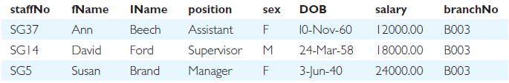
Example 7.3 - Create Horizontal View (Rows)
  Create view so that manager at branch B003 can only see details for staff who work in his or her office.
CREATE VIEW Manager3Staff
  AS SELECT *
  FROM Staff
  WHERE branchNo = ‘B003’;
Pearson Education © 2014

Slide 31
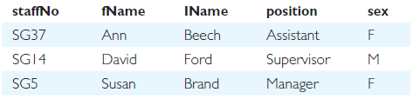
Example 7.4 - Create Vertical View (Columns)
Create view of staff details at branch B003 excluding salaries (view is good for security).
CREATE VIEW Staff3
  AS SELECT staffNo, fName, lName, position, sex
  FROM Staff
  WHERE branchNo = ‘B003’;
Pearson Education © 2014

Slide 32
Example 7.5 - Grouped and Joined Views
Create view of staff who manage properties for rent, including branch number they work at, staff number, and number of properties they manage.
CREATE VIEW StaffPropCnt (branchNo, staffNo, cnt)
  AS SELECT s.branchNo, s.staffNo, COUNT(*)
  FROM Staff s, PropertyForRent p
  WHERE s.staffNo = p.staffNo
  GROUP BY s.branchNo, s.staffNo;
  -- It will Collapse by branchNo, staffNo
Pearson Education © 2014

Slide 33
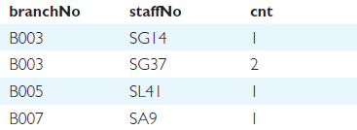
Example 7.3 - Grouped and Joined Views
Pearson Education © 2014

Slide 34
SQL - DROP VIEW
  DROP VIEW ViewName [RESTRICT | CASCADE]
Causes definition of view to be deleted from database.
For example:
  DROP VIEW Manager3Staff;
Pearson Education © 2014

Slide 35
SQL - DROP VIEW
With CASCADE, all related dependent objects are deleted; i.e. any views defined on view being dropped (a view can call another view inside it).
With RESTRICT (default), if any other objects depend for their existence on continued existence of view being dropped, command is rejected.
Pearson Education © 2014

Slide 36
View Resolution
Count number of properties managed by each member at branch B003.
  SELECT staffNo, cnt
  FROM StaffPropCnt -- a view
  WHERE branchNo = ‘B003’
  ORDER BY staffNo;
Pearson Education © 2014

Slide 37
View Resolution
(a) View column names in SELECT list are translated into their corresponding column names in the defining query:
  SELECT s.staffNo As staffNo, COUNT(*) As cnt
(b) View names in FROM are replaced with corresponding FROM lists of defining query:
  FROM Staff s, PropertyForRent p
  (The SQL code from the view is put in)
Pearson Education © 2014

Slide 38
View Resolution
(c) WHERE from user query is combined with WHERE of defining query using AND:
  WHERE s.staffNo = p.staffNo AND branchNo = ‘B003’
(d) GROUP BY and HAVING clauses copied from defining query:
  GROUP BY s.branchNo, s.staffNo
(e) ORDER BY copied from query with view column name translated into defining query column name
  ORDER BY s.staffNo
Pearson Education © 2014

Slide 39
View Resolution
(f) Final merged query is now executed to produce the result:
  SELECT s.staffNo AS staffNo, COUNT(*) AS cnt
  FROM Staff s, PropertyForRent p
  WHERE s.staffNo = p.staffNo AND
  branchNo = ‘B003’
  GROUP BY s.branchNo, s.staffNo
  ORDER BY s.staffNo;
Pearson Education © 2014

Slide 40
Restrictions on Views
SQL imposes several restrictions on creation and use of views.
(a) If column in view is based on an aggregate function:
  Column may appear only in SELECT and ORDER BY clauses of queries that access view.
  Column may not be used in WHERE nor be an argument to an aggregate function in any query based on view.
Pearson Education © 2014

Slide 41
Restrictions on Views
For example, following query would fail:
  SELECT *
  FROM StaffPropCnt
  WHERE cnt > 2;
Pearson Education © 2014

Slide 42
Restrictions on Views
(b) Grouped view may never be joined with a base table or a view.
For example, StaffPropCnt view is a grouped view, so any attempt to join this view with another table or view fails.
Pearson Education © 2014

Slide 43
View Updatability
All updates to base table reflected in all views that encompass base table.
Similarly, may expect that if view is updated then base table(s) will reflect change.
Pearson Education © 2014

Slide 44
View Updatability
However, consider again view StaffPropCnt.
If we tried to insert record showing that at branch B003, SG5 manages 2 properties:
  INSERT INTO StaffPropCnt
  VALUES (‘B003’, ‘SG5’, 2);
Have to insert 2 records into PropertyForRent showing which properties SG5 manages. However, do not know which properties they are; i.e. do not know primary keys!
Pearson Education © 2014

Slide 45
View Updatability
If change definition of view and replace count with actual property numbers:
  CREATE VIEW StaffPropList (branchNo,
  staffNo, propertyNo)
  AS SELECT s.branchNo, s.staffNo, p.propertyNo
  FROM Staff s, PropertyForRent p
  WHERE s.staffNo = p.staffNo;
Pearson Education © 2014

Slide 46
View Updatability
Now try to insert the record:
  INSERT INTO StaffPropList
  VALUES (‘B003’, ‘SG5’, ‘PG19’);
Still problem, because in PropertyForRent all columns except postcode/staffNo are not allowed nulls.
However, have no way of giving remaining non-null columns values.
Pearson Education © 2014

Slide 47
View Updatability
ISO specifies that a view is updatable if and only if:
- DISTINCT is not specified.
- Every element in SELECT list of defining query is a column name and no column appears more than once.
- FROM clause specifies only one table, excluding any views based on a join, union, intersection or difference.
- No nested SELECT referencing outer table.
- No GROUP BY or HAVING clause.
- Also, every row added through view must not violate integrity constraints of base table.
Pearson Education © 2014

Slide 48
Updatable View
For view to be updatable, DBMS must be able to trace any row or column back to its row or column in the source table.
Pearson Education © 2014

Slide 49
WITH CHECK OPTION
Rows exist in a view because they satisfy WHERE condition of defining query.
If a row changes and no longer satisfies condition, it disappears from the view.
New rows appear within view when insert/update on view cause them to satisfy WHERE condition.
Rows that enter or leave a view are called migrating rows.
WITH CHECK OPTION prohibits a row migrating out of the view.
Pearson Education © 2014

Slide 50
WITH CHECK OPTION
LOCAL/CASCADED apply to view hierarchies.
With LOCAL, any row insert/update on view and any view directly or indirectly defined on this view must not cause row to disappear from view unless row also disappears from derived view/table.
With CASCADED (default), any row insert/ update on this view and on any view directly or indirectly defined on this view must not cause row to disappear from the view.
Pearson Education © 2014

Slide 51
Example 7.6 - WITH CHECK OPTION
  CREATE VIEW Manager3Staff
  AS SELECT *
  FROM Staff
  WHERE branchNo = ‘B003’
  WITH CHECK OPTION;
Cannot update branch number of row B003 to B002 as this would cause row to migrate from view.
Also cannot insert a row into view with a branch number that does not equal B003.
Pearson Education © 2014

Slide 52
Advantages of Views
Data independence
Currency
Improved security
Reduced complexity
Convenience
Customization
Data integrity
One view can call another view
Pearson Education © 2014

Slide 53
Disadvantages of Views
Update restriction
Structure restriction (e.g. Select * sets the
number of columns in the view,
and this can not be changed
even if a column is added
to the base table)
Performance
Pearson Education © 2014

Slide 54
View Materialization (Oracle does have this)
View resolution mechanism may be slow (consider joining 3 tables), particularly if view is accessed frequently.
View materialization stores view as temporary table when view is first queried.
Thereafter, queries based on materialized view can be faster than recomputing view each time.
Difficulty is maintaining the currency of view while base tables(s) are being updated.
Pearson Education © 2014

Slide 55

View Maintenance
View maintenance aims to apply only those changes necessary to keep view current.
Consider following view:
  CREATE VIEW StaffPropRent(staffNo)
  AS SELECT DISTINCT staffNo
  FROM PropertyForRent
  WHERE branchNo = ‘B003’ AND
  rent > 400;
Pearson Education © 2014

Slide 56
View Materialization
If insert row into PropertyForRent with rent ≤400 then view(materialized(temp table)) would be unchanged.
If insert row for property PG24 at branch B003 with staffNo = SG19 and rent = 550, then row would appear in materialized view (add row to temporary table).
If insert row for property PG54 at branch B003 with staffNo = SG37 and rent = 450, then no new row would need to be added to materialized view (already there).
If delete property PG24, row should be deleted from materialized view.
If delete property PG54, then row for PG37 should not be deleted (because of existing property PG21).
Pearson Education © 2014

Slide 57
Access Control - Authorization Identifiers and Ownership
Authorization identifier is normal SQL identifier used to establish identity of a user. Usually has an associated password.
Used to determine which objects user may reference and what operations may be performed on those objects.
Each object created in SQL has an owner, as defined in AUTHORIZATION clause of schema to which object belongs.
Pearson Education © 2014

Slide 58
Privileges
Actions user permitted to carry out on given base table or view:
SELECT Retrieve data from a table.
INSERT Insert new rows into a table.
UPDATE Modify rows of data in a table.
DELETE Delete rows of data from a table.
REFERENCES Reference columns of named table in integrity constraints.
USAGE Use domains, collations, character sets, and translations.
Pearson Education © 2014

Slide 59
Privileges
Can restrict INSERT/UPDATE/REFERENCES to named columns.
Owner of table must grant other users the necessary privileges using GRANT statement.
To create view, user must have SELECT privilege on all tables that make up view and REFERENCES privilege on the named columns.
Pearson Education © 2014

Slide 60
GRANT
  GRANT {PrivilegeList | ALL PRIVILEGES}
  ON ObjectName
  TO {AuthorizationIdList | PUBLIC}
  [WITH GRANT OPTION]
PrivilegeList consists of one or more of above privileges separated by commas.
ALL PRIVILEGES grants all privileges to a user.
Pearson Education © 2014

Slide 61
GRANT
PUBLIC allows access to be granted to all present and future authorized users.
ObjectName can be a base table, view, domain, character set, collation or translation.
WITH GRANT OPTION allows privileges to be passed on.
Pearson Education © 2014

Slide 62
Example 7.7/8 - GRANT
Give Manager full privileges to Staff table.
  GRANT ALL PRIVILEGES
  ON Staff
  TO Manager WITH GRANT OPTION;
Give users Personnel and Director SELECT, and UPDATE on column salary, of Staff table.
  GRANT SELECT, UPDATE (salary)
  ON Staff
  TO Personnel, Director;
Pearson Education © 2014

Slide 63
Example 7.9 - GRANT Specific Privileges to PUBLIC
Give all users SELECT on Branch table.
  GRANT SELECT
  ON Branch
  TO PUBLIC;
Pearson Education © 2014

Slide 64
REVOKE
REVOKE takes away privileges granted with GRANT.
  REVOKE [GRANT OPTION FOR]
  {PrivilegeList | ALL PRIVILEGES}
  ON ObjectName
  FROM {AuthorizationIdList | PUBLIC}
  [RESTRICT | CASCADE]
ALL PRIVILEGES refers to all privileges granted to a user by user revoking privileges.
Pearson Education © 2014

Slide 65
REVOKE
GRANT OPTION FOR allows privileges passed on via WITH GRANT OPTION of GRANT to be revoked separately from the privileges themselves.
REVOKE fails if it results in an abandoned object, such as a view, unless the CASCADE keyword has been specified.
Privileges granted to this user by other users are not affected.
Pearson Education © 2014

Slide 66
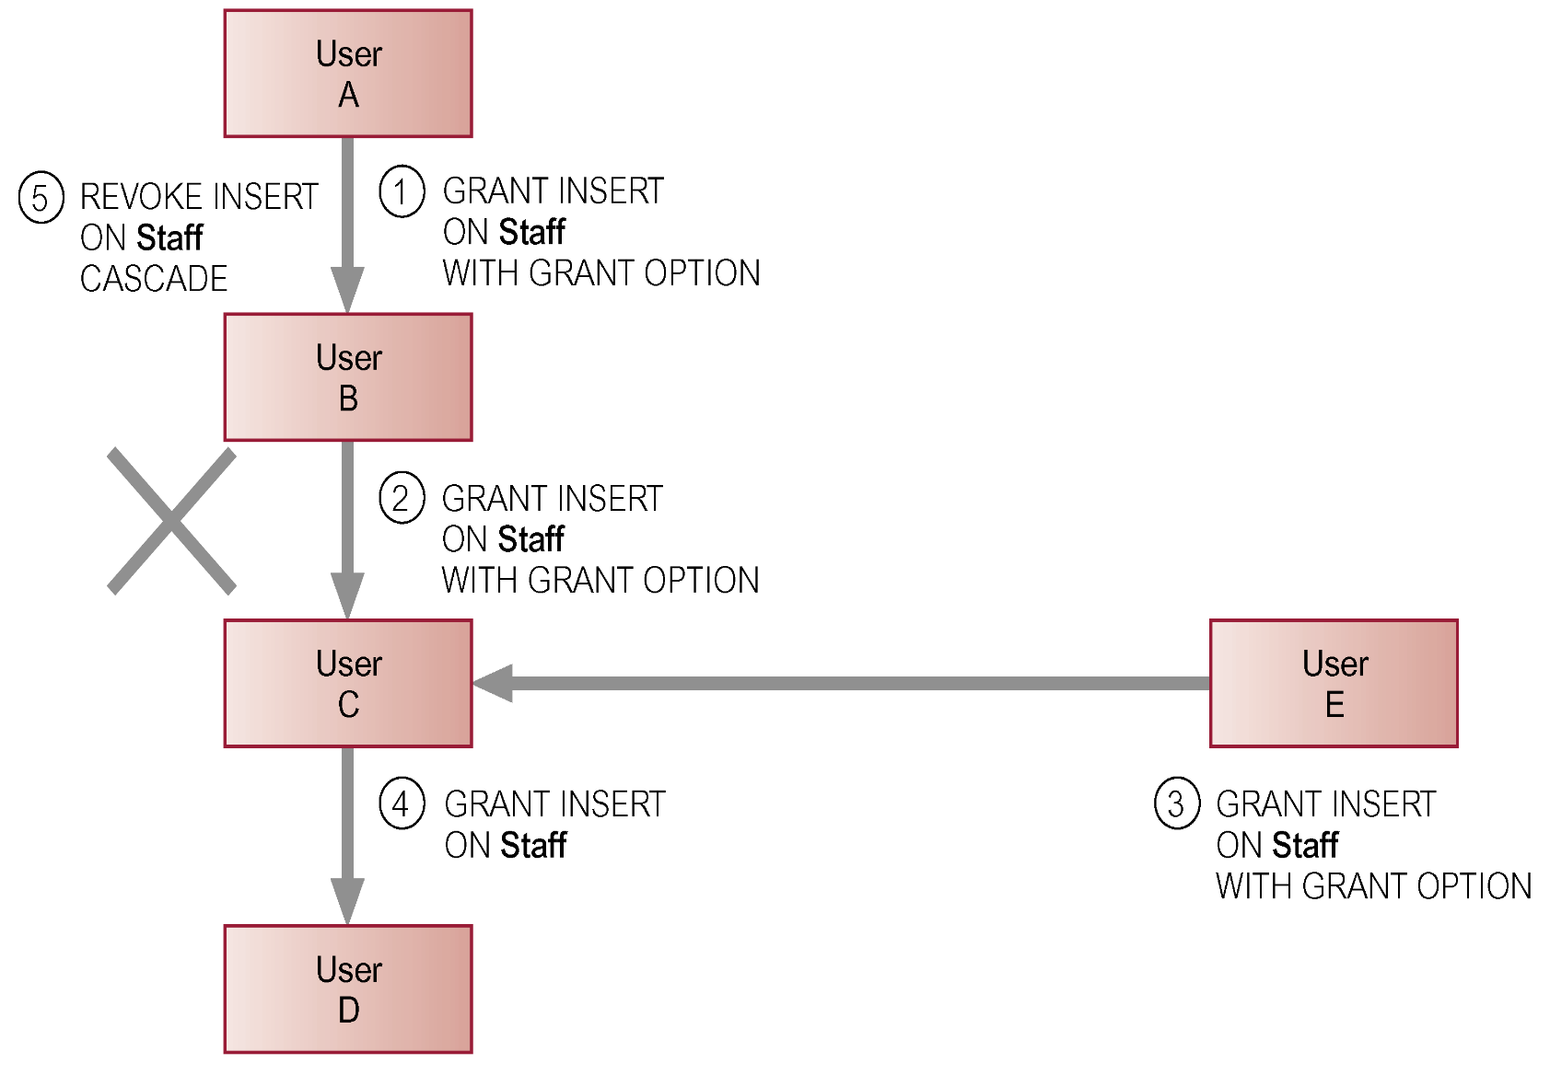
REVOKE - Optional
Pearson Education © 2014

Slide 67
Example 7.10/11 - REVOKE Specific Privileges
Revoke privilege SELECT on Branch table from all users.
  REVOKE SELECT
  ON Branch
  FROM PUBLIC;
Revoke all privileges given to Director on Staff table.
  REVOKE ALL PRIVILEGES
  ON Staff
  FROM Director;
Pearson Education © 2014

Slide 68
Tell them what they need to know for the exam.
Many more details in the textbook, as usual!

